Slide 1
Blacktown Chinese Christian Church
Welcome to Our English Service 26.01.2025
English Service 9:45 – 11:00 am
Worship Songs: Passage: Speaker: Topic: Response Song: Announcements and Closing Prayer Benediction
This I Believe Rock Of Ages Christ Is Enough John 6:61-71 TBA TBA TBA

Slide 2
BCCC english service

Slide 3

Please keep all phones on silent

Slide 4
This I Believe
Ben Fielding, Matt Crocker © 2014 Hillsong Music Publishing Australia CCLI Licence No. 5485849 . CCLI Song number: 7018338

Slide 5
Verse 1
Our Father everlasting
The all-creating One
God Almighty

Slide 6
Verse 1
Through your Holy Spirit
Conceiving Christ the Son
Jesus our Saviour

Slide 7
Chorus
I believe in God our Father
I believe in Christ the Son
I believe in the Holy Spirit
Our God is three in One

Slide 8
Chorus
I believe in the resurrection
That we will rise again
For I believe in the Name of Jesus

Slide 9
Verse 2
Our Judge and our Defender
Suffered and crucified
Forgiveness is in You

Slide 10
Verse 2
Descended into darkness
You rose in glorious light
Forever seated high

Slide 11
Chorus
I believe in God our Father
I believe in Christ the Son
I believe in the Holy Spirit
Our God is three in One

Slide 12
Chorus
I believe in the resurrection
That we will rise again
For I believe in the Name of Jesus

Slide 13
Bridge 1
I believe in You
I believe You rose again
I believe that Jesus Christ is Lord
(x2)

Slide 14
Chorus 2
I believe in life eternal
I believe in the virgin birth
I believe in the saints' communion
And in Your Holy Church

Slide 15
Chorus 2
I believe in the resurrection
When Jesus comes again
For I believe in the Name of Jesus

Slide 16
Chorus
I believe in God our Father
I believe in Christ the Son
I believe in the Holy Spirit
Our God is three in One

Slide 17
Chorus
I believe in the resurrection
That we will rise again
For I believe in the Name of Jesus

Slide 18
Tag
For I believe in the Name of Jesus
For I believe in the Name of Jesus

Slide 19
Rock Of Ages
Words by Rev A.M. Toplady, Music by Ruth Buchanan 1998 Australian Fellowship of Evangelical Students CCLI . CCLI Song number: 293103

Slide 20
Verse 1
Rock of ages cleft for me
Hide me now my refuge be
Let the water and the blood

Slide 21
Verse 1
From Your wounded side which flowed
Be for sin the double cure
Cleanse me from its guilt and power

Slide 22
Verse 2
Not the labours of my hands
Can fulfil Your law’s demands
Could my zeal no respite know

Slide 23
Verse 2
Could my tears forever flow
All for sin could not atone
You must save and You alone

Slide 24
Verse 3
Nothing in my hand I bring
Simply to Your cross I cling
Naked come to You for dress

Slide 25
Verse 3
Helpless look to You for grace
Stained by sin to You I cry
Wash me Saviour or I die

Slide 26
Verse 4
While I draw this fleeting breath
When my eyelids close in death
When I soar through realms unknown
Bow before the judgement throne

Slide 27
Verse 4
Hide me then my refuge be
Rock of ages cleft for me-
When I soar through realms unknown
Bow before the judgement throne

Slide 28
Verse 4
Hide me then my refuge be
Rock of ages cleft for me

Slide 29
Christ Is Enough
Jonas Myrin, Reuben Morgan © 2012 Hillsong MP Songs (Admin. by Hillsong Music Publishing Australia) Hillsong Music Publishing Australia CCLI Licence No. 5485849 . CCLI Song number: 6514035

Slide 30
Verse 1
Christ is my reward
And all of my devotion
Now there's nothing in this world
That could ever satisfy

Slide 31
Pre-Chorus
Through every trial, my soul will sing
No turning back, I’ve been set free

Slide 32
Chorus
Christ is enough for me
Christ is enough for me
Everything I need is in You
Everything I need

Slide 33
Verse 2
Christ my all in all
The joy of my salvation
And this hope will never fail
Heaven is our home

Slide 34
Pre-Chorus
Through every storm, my soul will sing
Jesus is here, to God be the glory

Slide 35
Chorus
Christ is enough for me
Christ is enough for me
Everything I need is in You
Everything I need

Slide 36
Bridge
I have decided to follow Jesus
No turning back, no turning back
I have decided to follow Jesus
No turning back, no turning back

Slide 37
Bridge
The cross before me, the world behind me
No turning back, no turning back
The cross before me, the world behind me
No turning back, no turning back

Slide 38
Chorus
Christ is enough for me
Christ is enough for me
Everything I need is in You
Everything I need

Slide 39
Chorus 2
Christ is enough for me
Christ is enough for me
Everything I need is in You
Everything I need

Slide 40
Bridge
I have decided to follow Jesus
No turning back, no turning back
I have decided to follow Jesus
No turning back, no turning back

Slide 41
Bridge
I have decided to follow Jesus
No turning back, no turning back
I have decided to follow Jesus
No turning back, no turning back

Slide 42

Bible reading

Slide 43
John 6:61-71
⁶¹ Aware that his disciples were grumbling about this, Jesus said to them, “Does this offend you? ⁶² Then what if you see the Son of Man ascend to where he was before!

Slide 44
John 6:61-71
⁶³ The Spirit gives life; the flesh counts for nothing. The words I have spoken to you—they are full of the Spirit and life. ⁶⁴ Yet there are some of you who do not believe.” For Jesus had known from the beginning which of them did not believe and who would betray him.

Slide 45
John 6:61-71
⁶⁵ He went on to say, “This is why I told you that no one can come to me unless the Father has enabled them.”
⁶⁶ From this time many of his disciples turned back and no longer followed him.

Slide 46
John 6:61-71
⁶⁷ “You do not want to leave too, do you?” Jesus asked the Twelve.
⁶⁸ Simon Peter answered him, “Lord, to whom shall we go? You have the words of eternal life.

Slide 47
John 6:61-71
⁶⁹ We have come to believe and to know that you are the Holy One of God.”
⁷⁰ Then Jesus replied, “Have I not chosen you, the Twelve? Yet one of you is a devil!”

Slide 48
John 6:61-71
⁷¹ (He meant Judas, the son of Simon Iscariot, who, though one of the Twelve, was later to betray him.)

Slide 49
Announcements

Slide 50





Account name: Blacktown Chinese Christian Church
Account number: 4216 50263
Offering
BSB: 112 - 879
Please put in "offering" as the reference
The offering box is available at the back of the hall

Slide 51
Prayer points

Slide 52
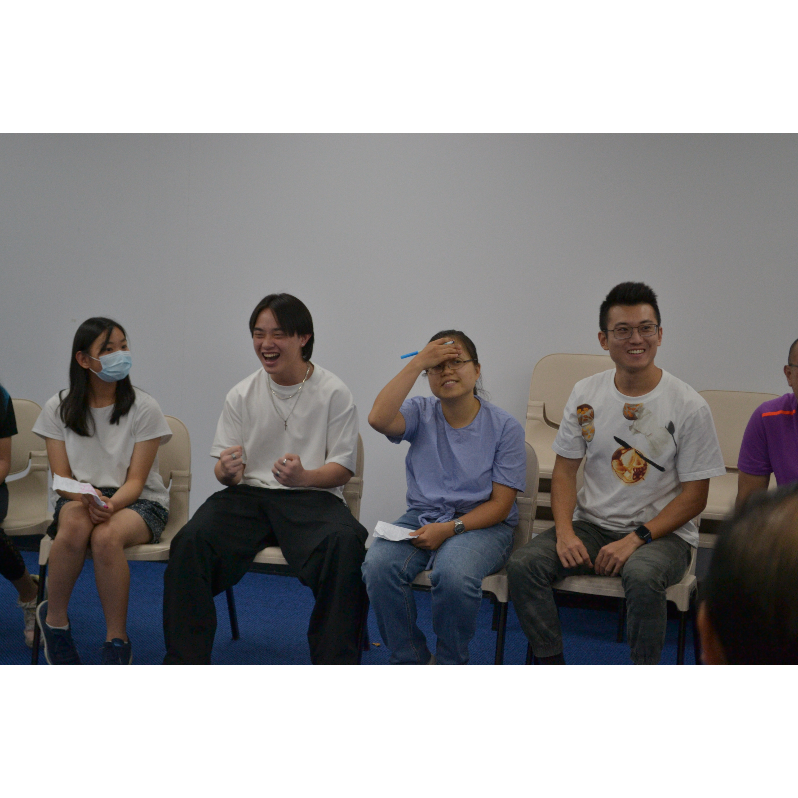
Mingle time!

